Slide 1

Chapter 06: Compiling to the Assembly Level Part 2 (Sections 6.4-6.5)
Notes:
This week we are going deeper into compiling C++ programs to Assembly.

Slide 2
Objectives
Learning Objectives
Describe how arrays & structures are stored in memory
Compute locations of array cells in memory
Define Jump Tables
Show how Jump Tables and Indexed Addressing can implement a Switch/Case structure
Notes:
We will discuss how arrays and structures are stored and access in memory.
This will involve computing locations of array cells.
We will define jump tables and show how they can be sued to implement a Switch/Case statement.

Slide 3
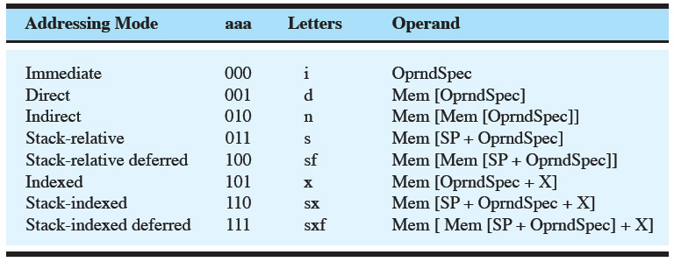
Addressing Modes
Programs with Arrays will use the index modes of addressing
Notes:
To work with arrays and jump tables, we will learn the last three addressing modes:
Indexed
Stack-Indexed
and
Stack-Indexed deferred
These will all utilize the index register which we have not used up until now.

Slide 4
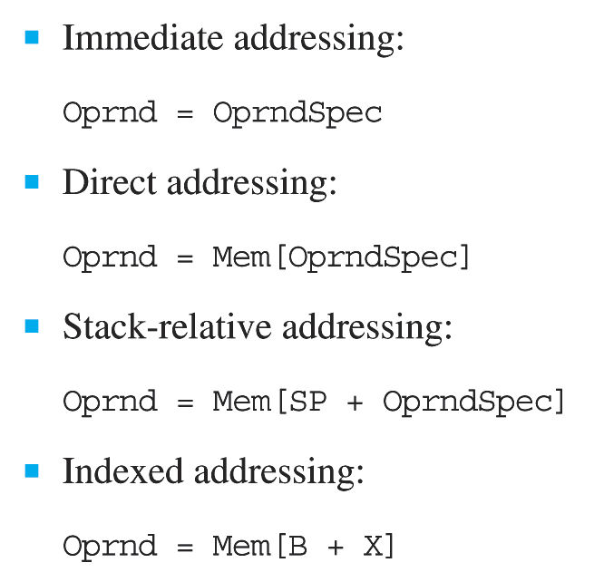
The relationship between the operand and the operand specifier for all the addressing modes
Notes:
Recall some of the other addressing modes and then see that the indexed ones are similar except the value in the index register is added in to obtain the memory address for the operand.

Slide 5
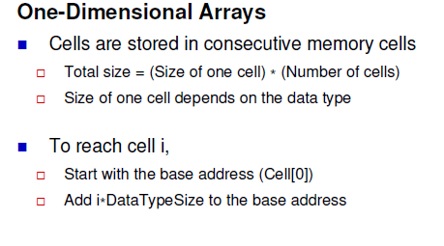
One dimensional arrays
Notes:
One dimensional arrays are stored in consecutive memory cells.
The total size of the array is the size of one cell – a byte, a word, or more – times the number of cells in the array.
To determine the address of the i^{th} cell – Take the base address of the 0th cell and add I times the size of one cell.

Slide 6
Indexed Addressing and Arrays
Used for accessing the elements of an array.
Operand: is memory address that is the sum of the base and index register.
Idea:
Base register contains the address of the first element of the array
Similar to the name of an array in a C program
The index register contains the index of the array
Notes:
Indexed addressing is used to access the elements of an array.
The Operand is the memory address that is the sum of the base of the array and the index register.
Just like when you call an element of an array in C with the name of the array and the index.
The index register contains the index of the array.

Slide 7
Arrays
Allocate the total number of bytes needed in a .BLOCK
To access element v[i]:
Load i into the index register
Multiply by number of bytes/element
Use index addressing (x)
OprndSpec must be the address of the first element of the array
Ie, the name of the array if use labels
Notes:
If the array is declared globally, then the total number of bytes needed must be allocated with the .BLOCK command.
To access the array, I is loaded into the index register.
Let’s look at the commandes

Slide 8
Arrays
Example. Assume v is an integer array
int v[4], j=3;
…
v[j] = 5;
Becomes
v: .BLOCK 8 ; int v[4]
j: .Word 3
…
LDA 5
LDX j, d
ASLX
STX v, x ; v is memory addr of
; the array, x is addr mode
Notes:
<click>
Here the array v is allocated with the .BLOCK command
<click>
The index j is allocated and set to the value of 3
<click> Note that because the array is an integer array and each integer takes up 2 bytes, the index must be multiplied by two in the index register to access the correct memory location.
<click> This command stores a value into the 4th element (j=3) of the v array because the index register currently contains a value of 6 or 3X2
The x indicateds the index addressing mode.

Slide 9
Indexed Addressing and Arrays
Figure 6.34 (see next slide).
DECI and DECO use indexed addressing
DECI vector,x and DECO vector,x
vector is the address of the first element of the vector
x indicates indexed addressing mode
Notes:
DECI & DECO can access the array by using index addressing also.

Slide 10
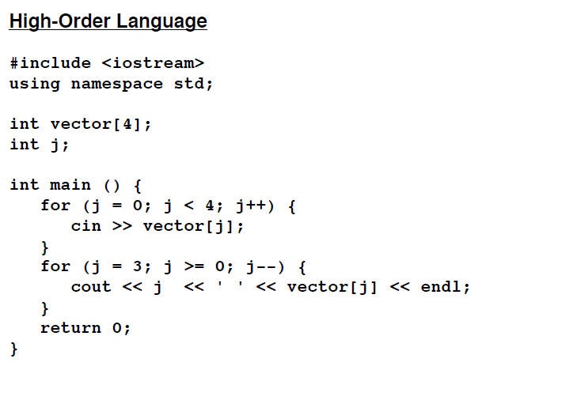
Global array example fig. 6.34
Notes:
Here is the C++ program in Fig 6.34.
It inputs 4 integers and outputs them in reverse order.

Slide 11
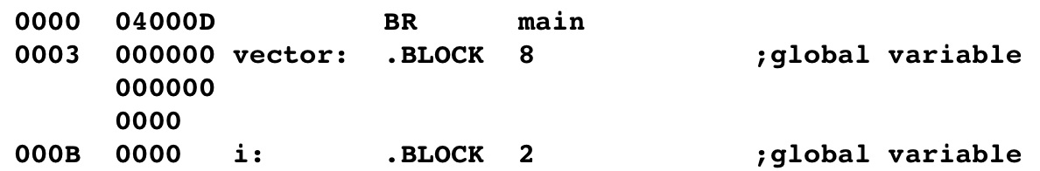
Indexed Addressing and Arrays
Notes:
Here are the statements that allocate space for the vector array and the index for it.

Slide 12
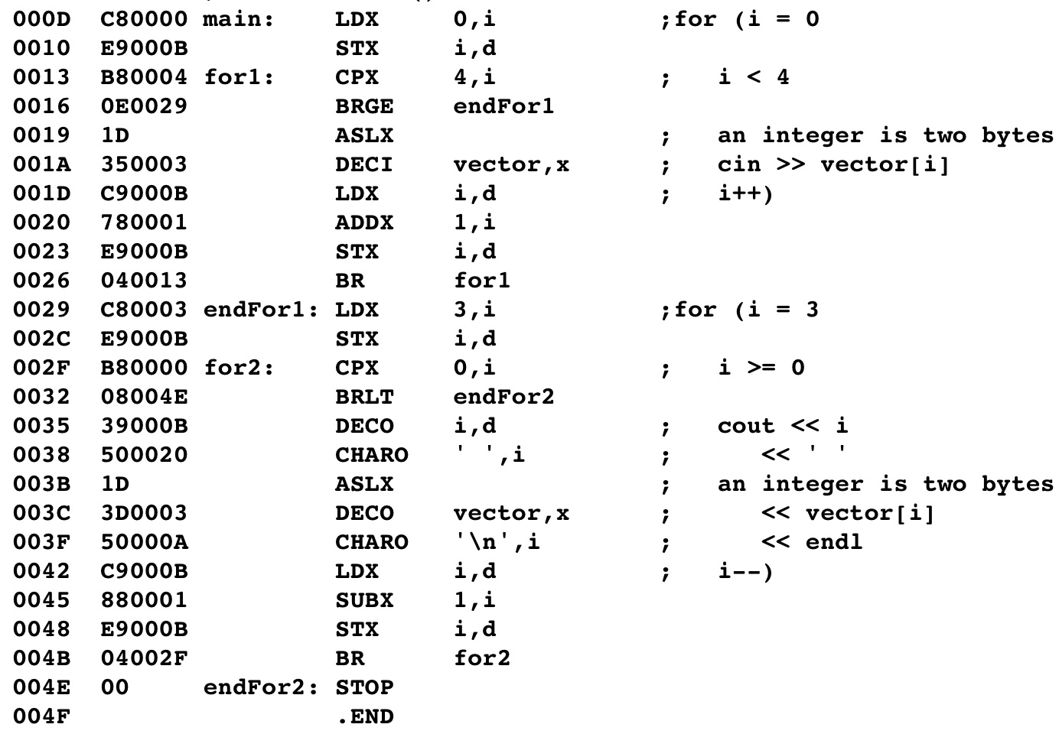
Indexed Addressing and Arrays
initialize the index register
multiply index register by two
input with indexed addressing
increment the index
initialize the index register
check loop condition
multiply index register by two
output with indexed addressing
decrement the index
Notes:
<click>
First 0 is loaded into the index register and stored at location I
<click>
As before the index is multiplied by 2 with a shift left because each integer requires 2 bytes.
<click>
DECI inputs the first integer and stores in the vector array at index 0
<click>
I is loaded and incremented & then stored again.
This is repeated until I = 4 and the BRGE statement at 0016 changes the control to endFor1
<click>
Here I is reset to 3 and a similar loop is set up to output in reverse.
<click>
This time it is compared to 0 in each loop.
<click>
The index is multiplied by two
<click>
DECO outputs the array element at I
<click>
And the index is decremented each time.

Slide 13
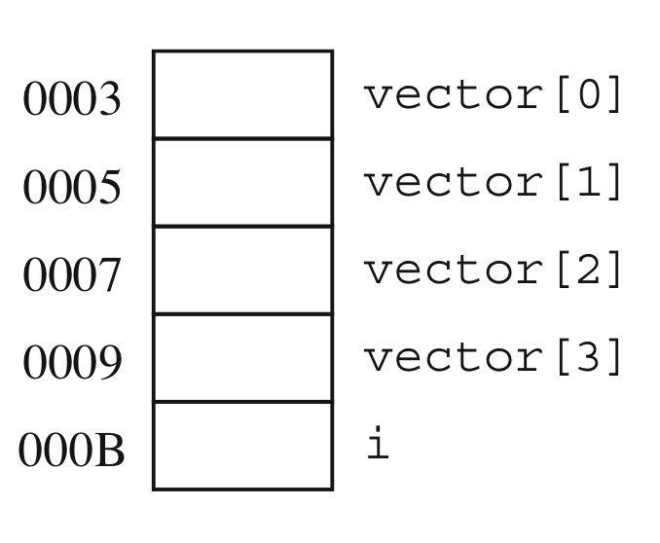
Accessing an array at Level HOL6 and Level Asmb5
The vector in memory
Notes:
This is the memory trace of the vector array and the index i

Slide 14
Local Arrays
Local arrays are allocated on the run-time stack
Stack-indexed addressing
Oprnd = Mem[SP + OprndSpec + X]
OprndSpec must be the address of the first element of the array.
use letters sx
Notes:
Local arrays like local variables are allocated on the run-time stack.
They use the stack-indexed addressing mode.
With this mode the operand is the value at memory location of the Stack pointer plus the operand specifier plus the value in the index register
As before the Operand Specifier is base address of the array

Slide 15
Local Arrays
Method:
The program allocates the appropriate number of bytes for the array on the stack using SUBSP
Deallocate the array using ADDSP
To access an element:
Load i into the index register
Multiply by number of bytes/element
Use stack-index addressing (sx)
Notes:
As with local variables, the memory for the local array is not allocated until run-time.
Also the stack pointer must be decremented with SUBSP to allocate the space an incremented with ADDSP
I must be handled in a similar way to global arrays.

Slide 16
Local Arrays
Example. Assume v is a local integer array
v[i] = 5;
Becomes
LDA 5
LDX i, s ; assume that i is on stack
ASLX
STX v, sx ; v is memory addr of
; the array, x is addr mode
Notes:
Let’s repeat our example for a local array.
The array elements are still accessed with LDX and STX commands
<click> This command stores a value into the v array on the stack at offset currently in the index register
The sx indicates the stack-index addressing mode.

Slide 17
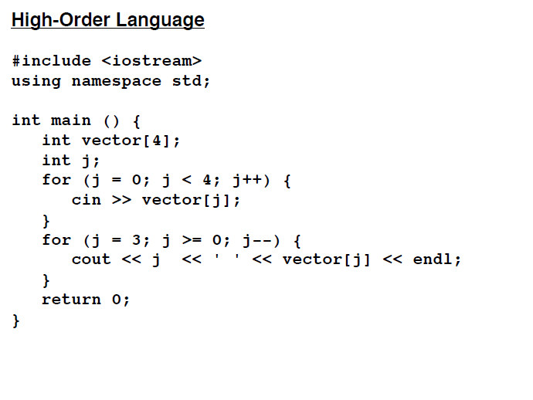
Local Arrays Example fig 6.36
Notes:
Here is the same C++ program as before with the vector array and index j declared as local variables.

Slide 18
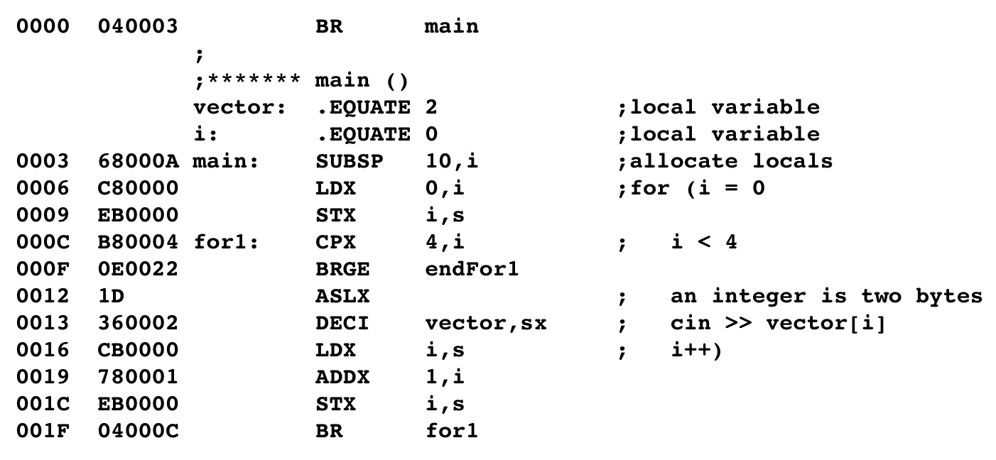
Local Arrays Example
Store local variables on stack
Input using stack-indexed address
Notes:
Here are the statements that have changed:
<click>
The array and index are allocated on the stack and the stack pointer is adjusted.
<click>
DECI inputs the integers to memory using stack-indexed addressing

Slide 19
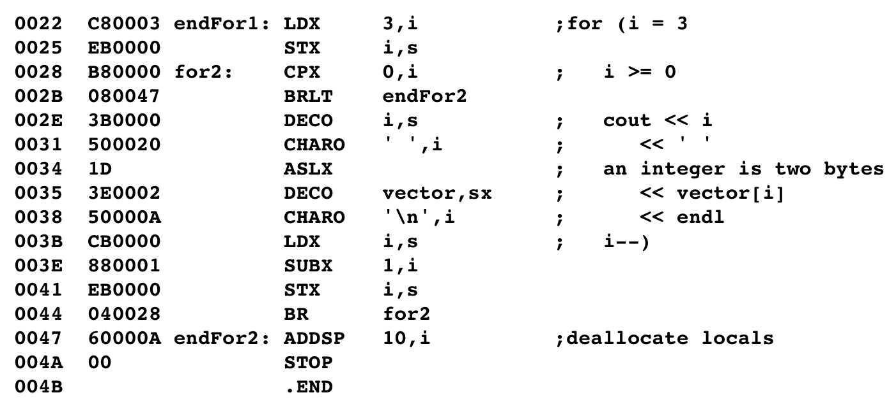
Local Arrays Example
Output using stack-indexed address
Deallocate the array & index
Notes:
<click>
DECO outputs the integers from memory using stack-indexed addressing
<click>
And at the end the stack pointer must be adjusted to deallocate the memory space.

Slide 20
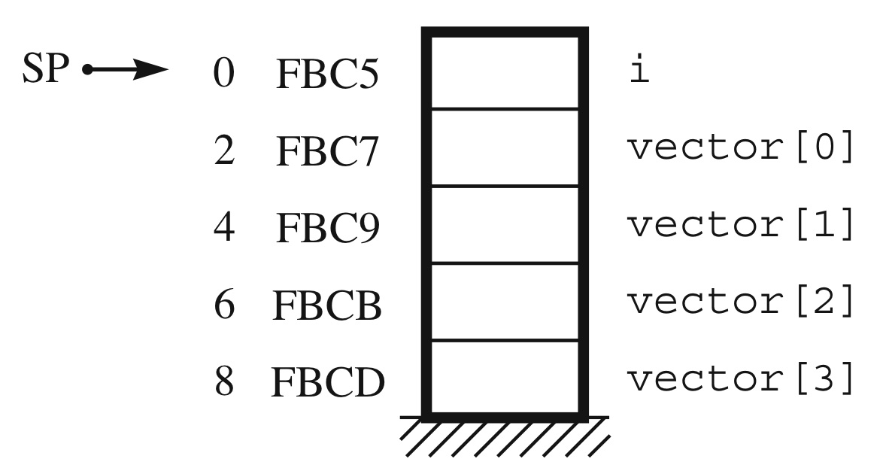
Local Arrays
The array on the stack
Notes:
This is the memory trace showing the vector array and the index I on the stack

Slide 21
Indexed Addressing and Arrays
Arrays as parameters
In C arrays are passed as pointers
In C++ arrays are passed by reference
Pass array name by placing its address on the stack
Problem:
To use indexed addressing need to use the memory address of the first element
How do we do this on the stack?
Notes:
Often arrays are passed to subroutines as parameters.
How do we do this when the array is on the stack?

Slide 22
Indexed Addressing and Arrays
Stack-indexed deferred addressing
Oprnd = Mem[Mem[SP + OprndSpec] + X]
Letters: sxf
Use:
Store the address of the first element of the array on the stack in the appropriate place
use MOVSPA, ADDA (with the offset and immediate addressing) and STA (with stack relative addressing.
In the subroutine, load the index variable from the stack into the index register
Multiply by the number of bytes per cell
Use sxf addressing
Notes:
Stack-indexed deferred addressing is used for this situation.
In this case, the base address of the array is stored on the stack. This is specified by a symbol pointing to an offset from the stack pointer similar to a parameter passed to a subroutine.
The value of the base address is obtained by accessing the memory at the location of the stack pointer plus the offset indicated by the symbol.
Once his base address is obtained the value in the index register can be used to determine the i^{th} element, the same as in the previous examples.
To see an example of this - see the powerpoint lecture on Fig 6.38

Slide 23
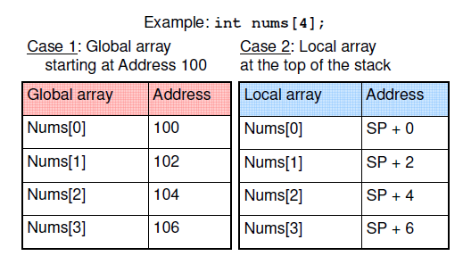
Array Storage Global Vs. Local
Notes:
Here is a comparison of the addresses of a global array starting at address 0100 and a local array that is stored at the top of the stack.
Once the base address of the array is determined, the indexing is the same.

Slide 24
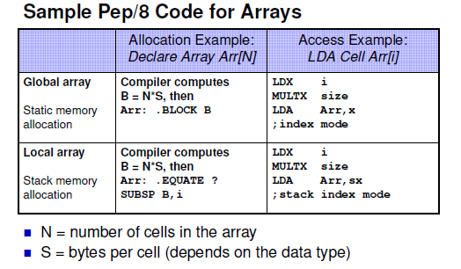
Pep/8 Array code Global Vs Local
Notes:
Here is a comparison of the way the compiler handles the global and local arrays and the commands that are used.

Slide 25
The Switch Statement
Can treat main memory as an array of bytes.
Indexes of the array correspond to byte addresses
Can translate the switch statement as an array of addresses
This array is called a jump table.
Notes:
The switch statement also uses the index register to access an array of addresses that start each case in the switch statement.
This array is called a jump table.

Slide 26
.ADDRESS
Used to generate code representing the address of a symbol
Syntax:
.ADDRSS symbol
Effect:
place the address represented by the symbol into the machine language program at that point
Notes:
This array is built using the pseudo-op .ADDRSS
This will place the address of the symbol into the machine language program.

Slide 27
.ADDRESS
Example:
assume Case0 is a label for address 0029
0013 .ADDRSS Case0
…
0029 case0: STRO msg0,d
In the machine code at 0013 will see
0013 0029
Notes:
Here is an example, that shows that the address for case0 will be put into the machine code at 0013

Slide 28
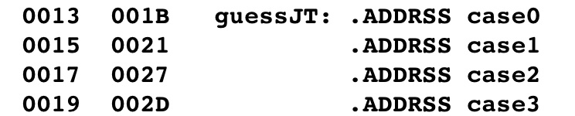
The Switch Statement
To implement a Switch statement:
Create a jump table using .ADDRSS
Use LDX to load the index register with the switch value
Insert a ASLX
An address takes two bytes
Execute a BR with indexed addressing
Notes:
Here we see that an array named guessJT is created to handle the 4 case statements.
As in the previous examples LDX will be used to load the index, ASLX will multiply it by 2 then a branch statement will use the address at the i^{th} element of the array.
To see more details on this see the powerpoint on Fig 6.40

Slide 29
Dynamic Memory Allocation
Programs can request memory allocation dynamically
Done in conjunction with the OS
Dynamic memory is allocated from the heap
Notes:
As we discussed in Chapter 2, programs can allocate memory dynamically from the heap. Let’s see how this is done at the assembly level.

Slide 30
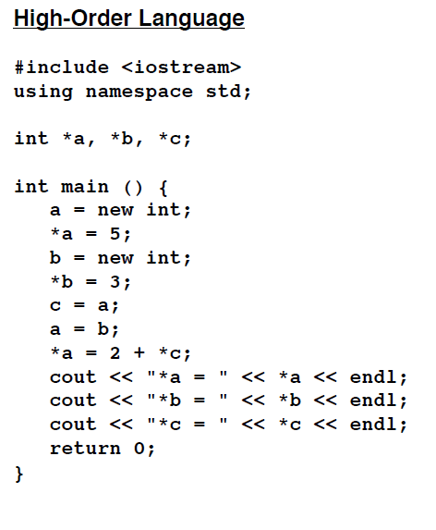
Dynamic Memory Allocation fig 6.41
Notes:
Here is the C++ program from Figure 6.41.
It uses pointers to variable address locations.

Slide 31
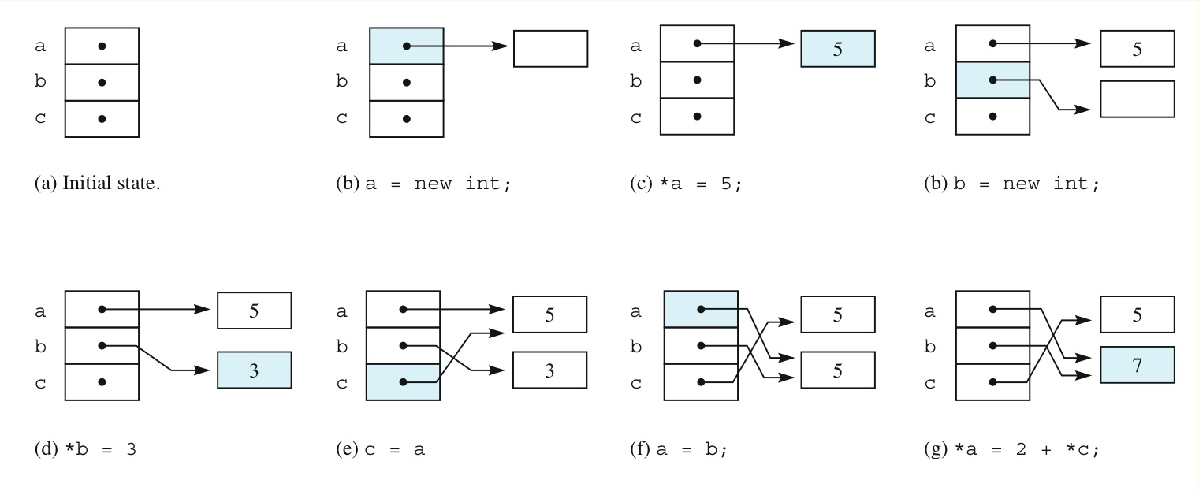
Dynamic Memory Allocation
3
Notes:
Here is a map that shows the pointers, the memory that they are pointing to, and the way they can be changed to point to different locations.

Slide 32
Dynamic Memory Allocation
Dynamic memory uses a heap which is allocated to the process by the OS
Process can request memory and free memory.
Memory management algorithms must be able to keep track of memory.
This code is part of the OS.
Notes:
Note the memory locations that the pointers are pointing to are not on the stack or in fixed memory. They are allocated on the heap.
The allocation process and the memory management algorithms are part of the Operating System.

Slide 33
Dynamic Memory Allocation
Pep/8 memory model simplifies the heap
Pep/8 memory model:
Heap is allocated in main memory at the end of the application program
New (or malloc) operator allocates storage from the heap
Heap grows downward
Once memory is allocated can never be deallocated
Notes:
As like other processes, the Pep/8 simplifies the heap.
It allocates the area after the end of the application program for this and it grows downward.
Once the memory is allocated it can never be deallocated. Tsk tsk – a memory leak.

Slide 34
Dynamic Memory Allocation
Pep/8 memory model
Compiler puts in code to allocate/manage heap
Compiler includes the new operator
This code/memory is placed at the bottom of the application program
See next slide
Notes:
The compiler – this would be you for the Pep/8- will put in code to allocate & manage the heap. This includes the new operator and the code & memory are placed at the bottom of the program.

Slide 35
Dynamic Memory Allocation
Pep/8 memory model - How the heap works
Variable/Symbol hpPtr contains the address of the first free byte in the heap
hpPtr is initialized to the first byte in the heap:
hpPtr: .ADDRSS heap
Heap: .BLOCK 1
Note that since this code occurs at the end of the application, none of the following memory is used by the program
Unfortunately, the stack could grow too big and clash with the heap
Notes:
The symbol hpPtr – heap pointer - contains the address of the first free byte of memory.
It is initialized with the .ADDRSS pseudo-op.
The heap storage begins after the pointer.
If the stack & the heap both grow too big they can over write each other and cause major program errors.

Slide 36
Dynamic Memory Allocation
Pep/8 memory model - How the heap works
When a program allocates memory with the new command, it must
Load the number of needed bytes into the accumulator
Then calls new
LDA 2,I
CALL new
Notes:
The program must load the number of bytes needed into the accumulator then call the new operator.

Slide 37
Dynamic Memory Allocation
Pep/8 memory model - How the heap works
New will load the address in the heap pointer (hpPtr) into the index register
This register will be used by the application for indirect addressing
LDX hpPtr,d ; hpPtr contains the address
; of the first unused byte in the
; heap
Notes:
The address in the heap pointer will be loaded into the index register.
The index register will be used for indirect addressing.

Slide 38
Dynamic Memory Allocation
Pep/8 memory model - How the heap works
Then new allocates the needed number of bytes
Adds the number of bytes needed (which are in the accumulator) to the current top-of-heap value (stored in hpPtr)
Then stores the result into the hpPtr location.
hpPtr now contains the address of the next unused byte in the heap
ADDA hpPtr,d
STA hpPtr,d
Notes:
New adds the number of bytes needed – as indicated in the accumulator – to the heap pointer and stores the result back to the heap pointer.
So the heap pointer always contains the next unused byte on the heap.

Slide 39
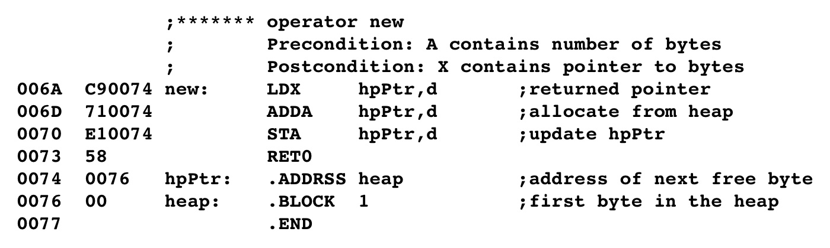
Dynamic Memory Allocation
Pep/8 memory model.
Compiler generated dynamic memory/functions
When new is called first load the value of the first unused heap byte into the index register.
Then add the value in the accumulator (ie, the number of bytes to be allocated) to the current heap address.
Then store the new heap address (the first free address in the heap) back into the heap pointer.
Initially, the value stored at hpPtr is the address of heap. No memory is yet allocated.
Notes:
Here is the process
<click>
Initially, the value stored at hpPtr is the address of heap. No memory is yet allocated.
<click>
When new is called first load the value of the first unused heap byte into the index register.
Then add the value in the accumulator to the current heap address.
Then store the new heap address (the next free address in the heap) back into the heap pointer.

Slide 40
Dynamic Memory Allocation
Using global pointer variables
Allocate storage for the variable with .BLOCK 2
Recall that a memory address is 16 bits or 2 bytes
Access the address stored at the pointer with direct addressing (d)
Access the value stored on the heap that the pointer is pointing to (Dereference the pointer) with indirect addressing (n)
Notes:
Like normal variables the pointers can be set up as global or local.
Let’s look a global pointers first.
It is allocated the same as a global variable.
Direct addressing will obtain the value of the address stored in the pointer.
Indirect addressing will obtain the value stored on the heap.

Slide 41
Dynamic Memory Allocation
Calling the new function
Put the number of bytes to be allocated into the accumulator
CALL new
The index register will contain the address of the allocated bytes
STX b,d
Notes:
Upon return from the new operator the index register contains the address of the allocated bytes.
This address must be stored to the pointer’s memory location.

Slide 42
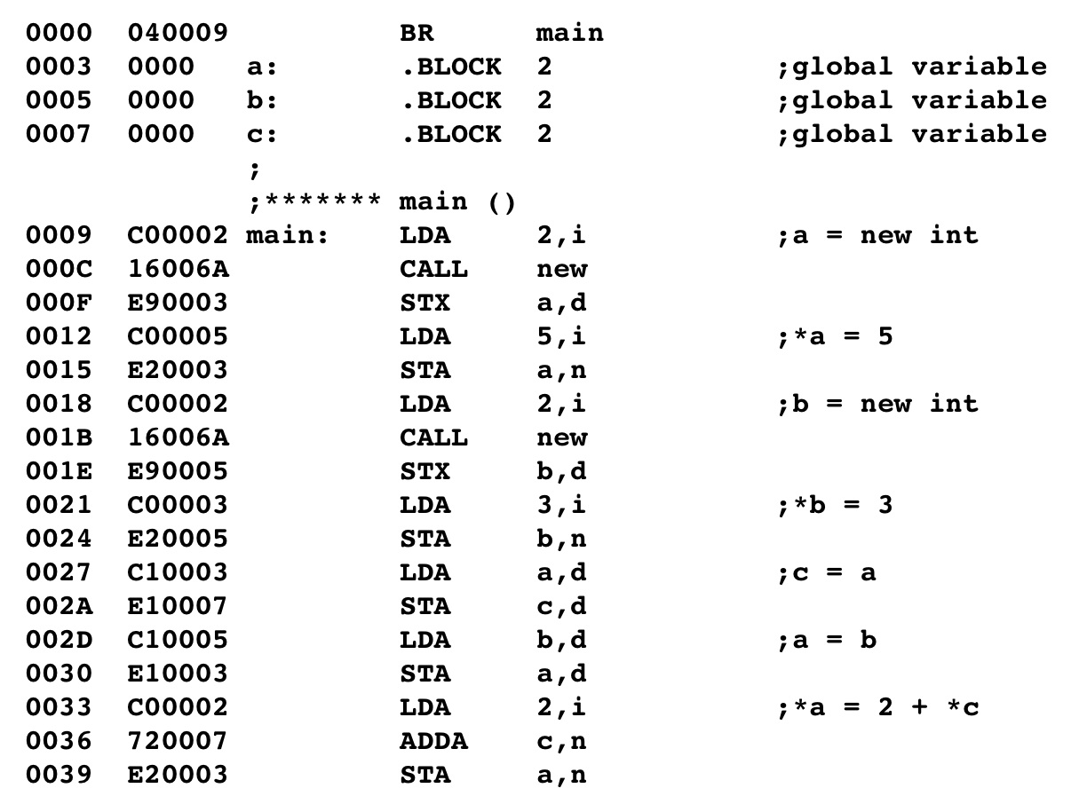
Dynamic Memory Allocation Example fig 6.41
Load Accumulator with number of bytes needed.
Call new
On return from call, the address of the first byte of the allocated memory is in the index register.
Save this address in the pointer.
Use the pointer with indirect addressing.
Notes:
Here is the Assembly language translation for Fig 6.41.
<click>
First the accumulator is loaded with 2 – the number of bytes needed.
<click>
Then new is called
<click>
Upon return the address in the index register must be saved in the pointer.
<click>
To access the value on the heap, indirect addressing is used.

Slide 43
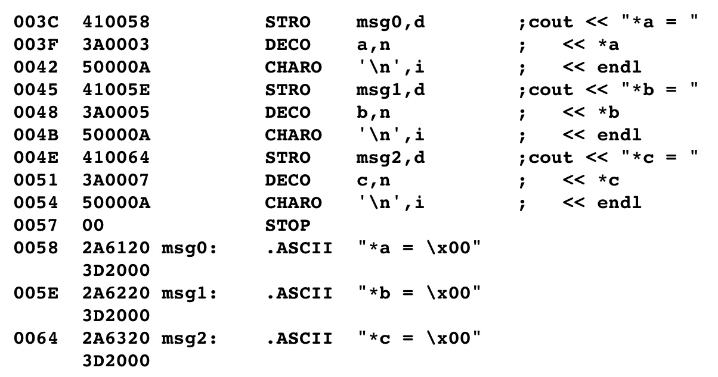
Indirect Addressing

Slide 44
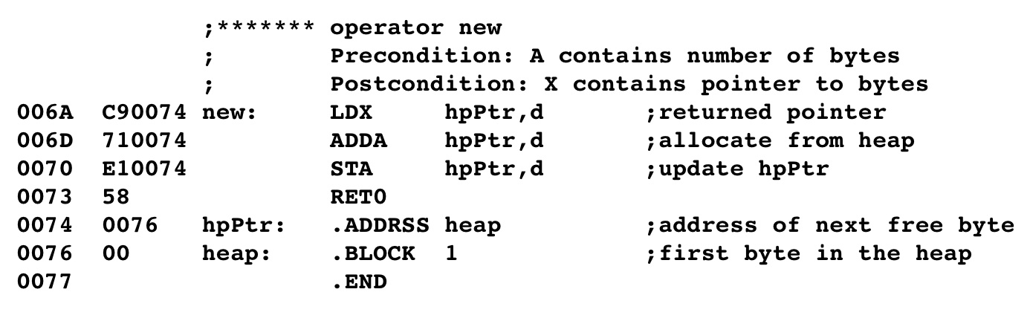
Indirect Addressing
Notes:
Here is the new operator at the end of the program, followed by the heap.

Slide 45
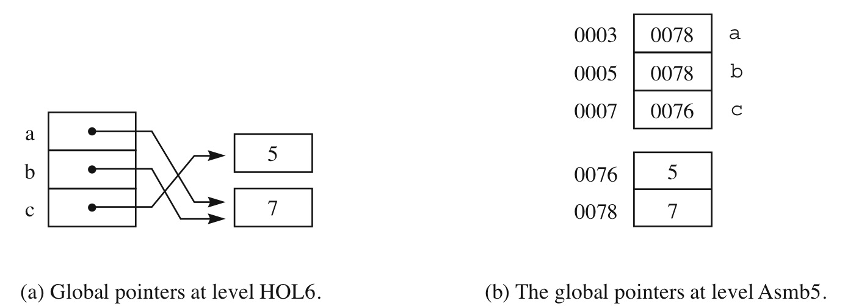
Indirect Addressing
The heap address is stored in the global pointer
Notes:
This shows the pointers in fixed memory containing the addresses of locations on the heap.
So the pointer variable contains an address.
And the value is in the memory of an address of an address.

Slide 46
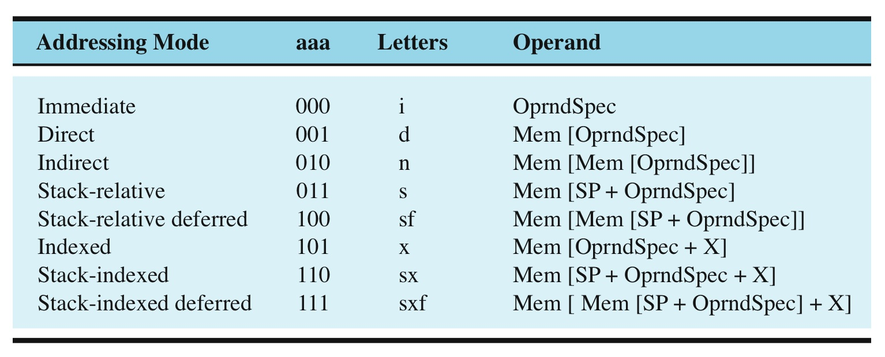
Indirect Addressing
Oprnd = Mem[ Mem[ OprndSpec] ]
Notes:
Here is how the CPU computes the Operand for indirect addressing.

Slide 47
Indirect Addressing
Some machines also have a double indirect mode
Oprnd = Mem[Mem[Mem[OprndSpec]]]
Notes:
Some machines have a double indirect mode.

Slide 48
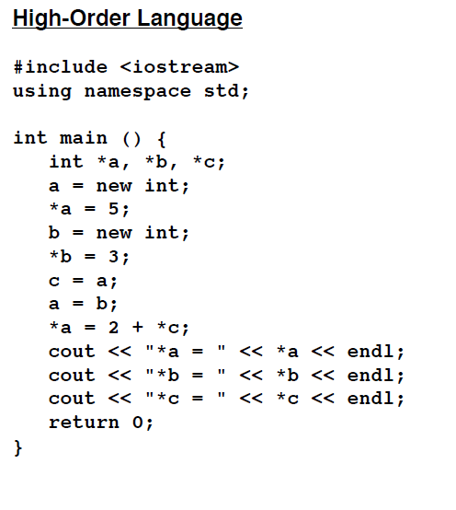
Dynamic Memory with local variables fig. 6.43
Notes:
Pointers can also be declared as local variables.

Slide 49
Dynamic Memory with local variables
Same as pass-by-reference
Allocate storage on the stack for the pointer using SUBSP
Access the pointer with stack-relative addressing (s)
Access the value stored on the heap that the pointer is pointing to (Dereference the pointer) with stack-relative deferred addressing (sf)
Notes:
These are allocated the same as Pass-by-Reference.
Storage is allocated with SUBSP
Access the address stored in the pointer with stack-relative addressing
Access the value stored on the heap with stack-relative deferred addressing

Slide 50
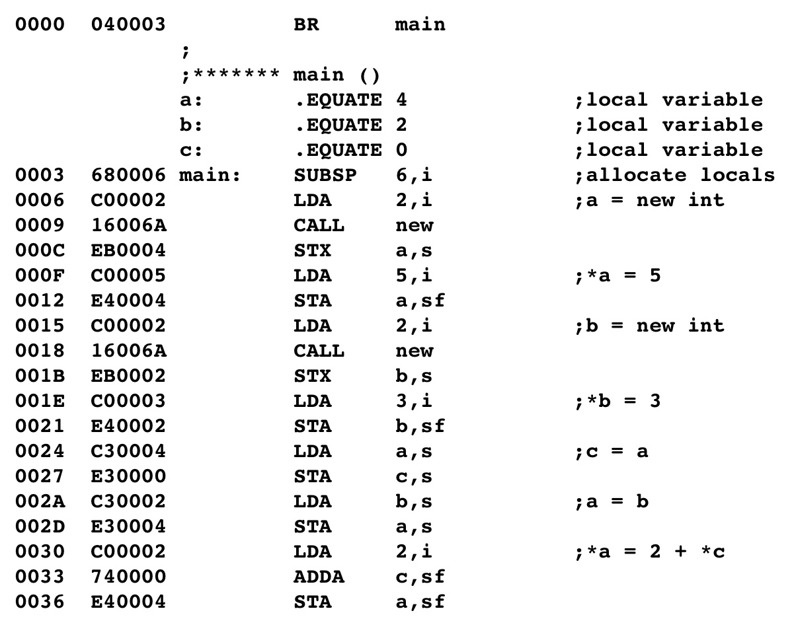
Dynamic Memory with local variables fig. 6.43
Notes:
Here is the Assembly Language translation for fig 6.43.
The commands that are different from the global pointers are circled.
After the pointers are allocated, the program is the same except for the addressing modes.

Slide 51
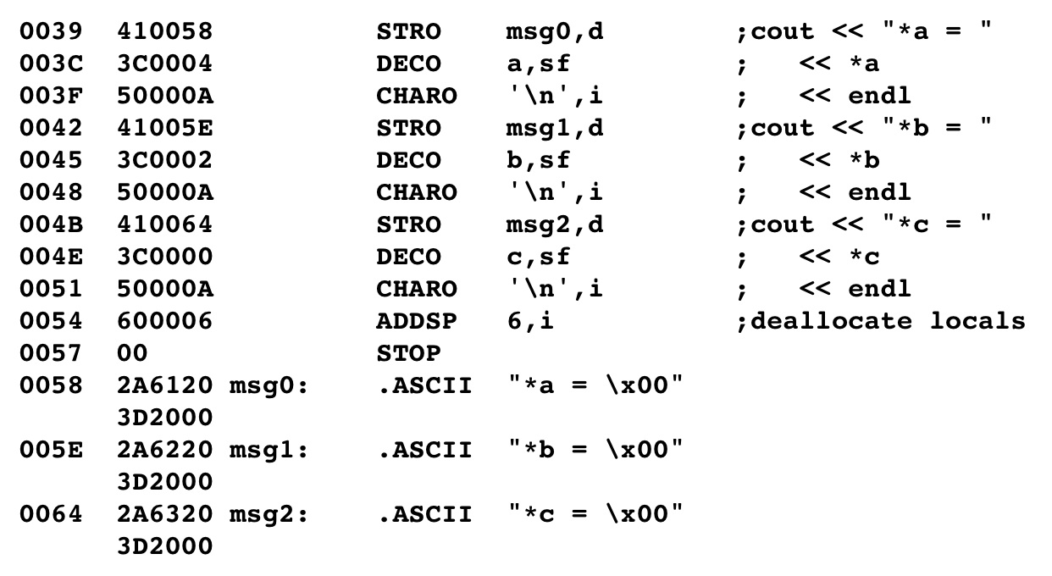
Dynamic Memory with local variables
Notes:
At the end the pointers need to be deallocated off the stack.

Slide 52
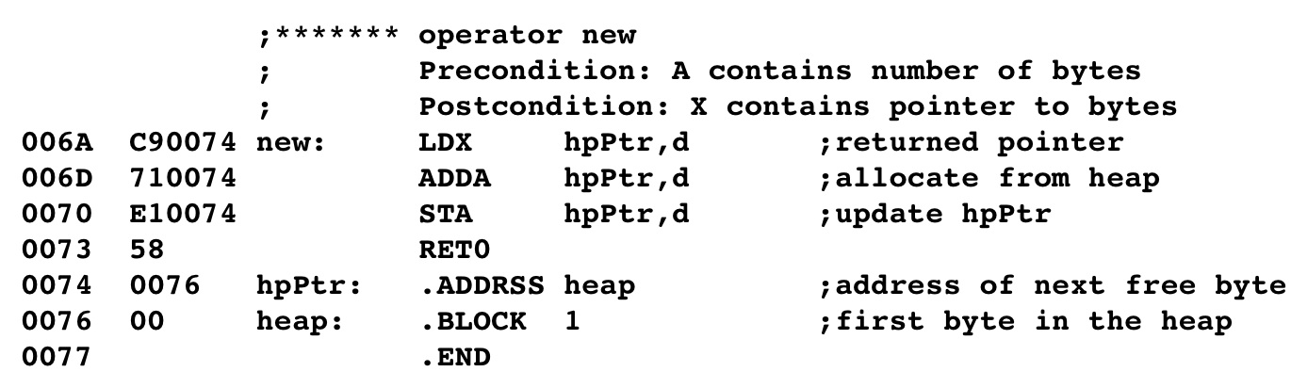
Dynamic Memory with local variables
Notes:
The new operator remains the same.

Slide 53
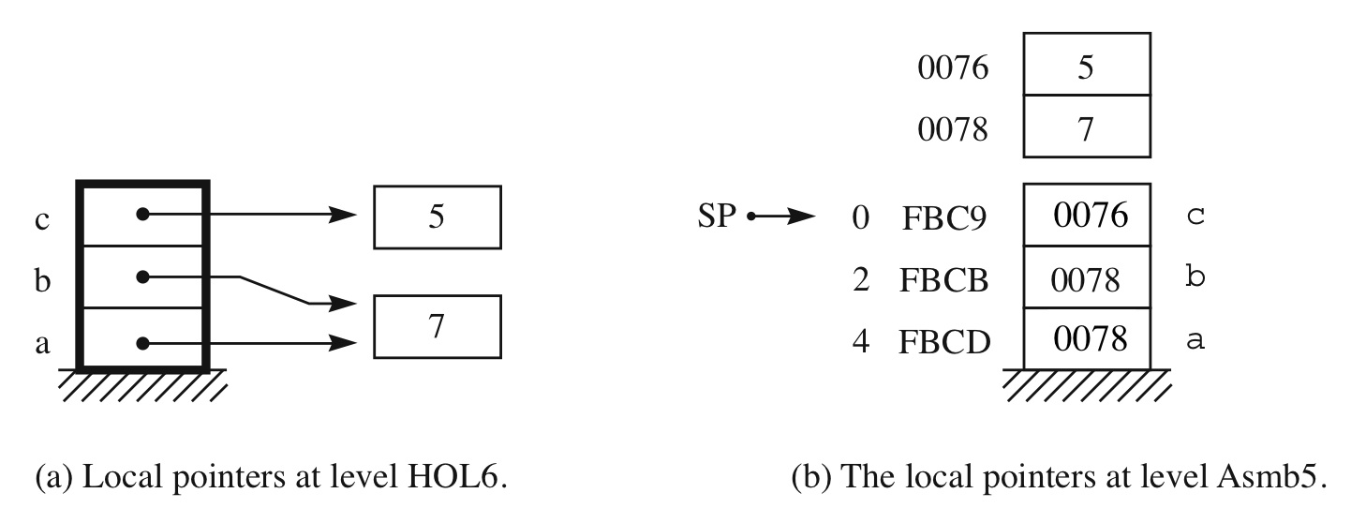
Indirect Addressing
Notes:
This shows a map of the pointers containing addresses of locations on the heap.

Slide 54
Structures fig. 6.45
C struct:
struct person{
char first;
char last;
int age;
char gender;
};
struct person bill;
fields
bill is a variable of type struct person
Notes:
C programming languages have a data structure called a structure that can contain different data types.
Here is shown the structure named person containing four fields.

Slide 55
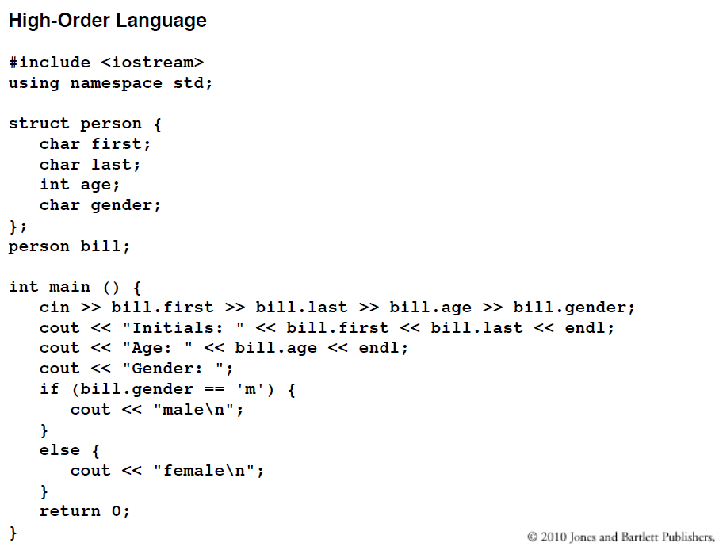
Structures fig. 6.45
Notes:
Here is the C++ program in Fig 6.45 containing the person structure as a global variable.

Slide 56
Structures at level HOL6 and Level Asmb5
Allocate storage for the total number of bytes needed for the structure.
Create .EQUATE symbols for each field of the structure.
To access a field:
Load the symbol of the field into the X register with immediate addressing
Use indexed addressing, using the name of the structure as the operand.
Notes:
Storage is allocated for the total number of bytes needed.
Symbols are created for each field using the .EQUATE pseudo-op.
The fields are accessed using the index register and immediate addressing.
This is very similar to accessing a global array, except symbols are used in place of the index.

Slide 57
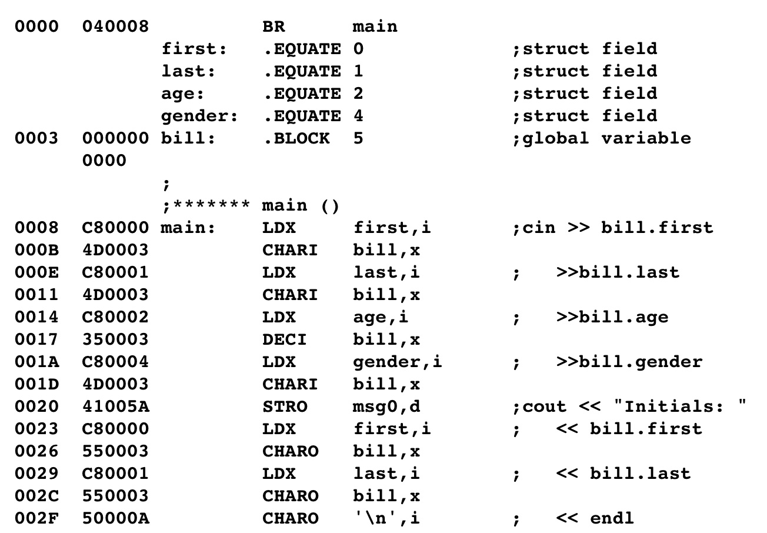
Structures at level HOL6 and Level Asmb5 (Cont’d)
.EQUATE's give the field offsets
Allocate storage for the entire struct
Load the offset for the field into the index register
Use indexed addressing with the name of the struct variable
Notes:
Here is the Assembly Language translation of fig 6.45
<click>
The fields are set up with symbols containing the proper offsets depending if 1 or 2 bytes are needed.
<click>
Space is allocated for the entire structure
<click>
The symbol value is loaded into the index register to provide the offset.
<click>
Data is stored in the structure using the name of the structure and indexed addressing

Slide 58
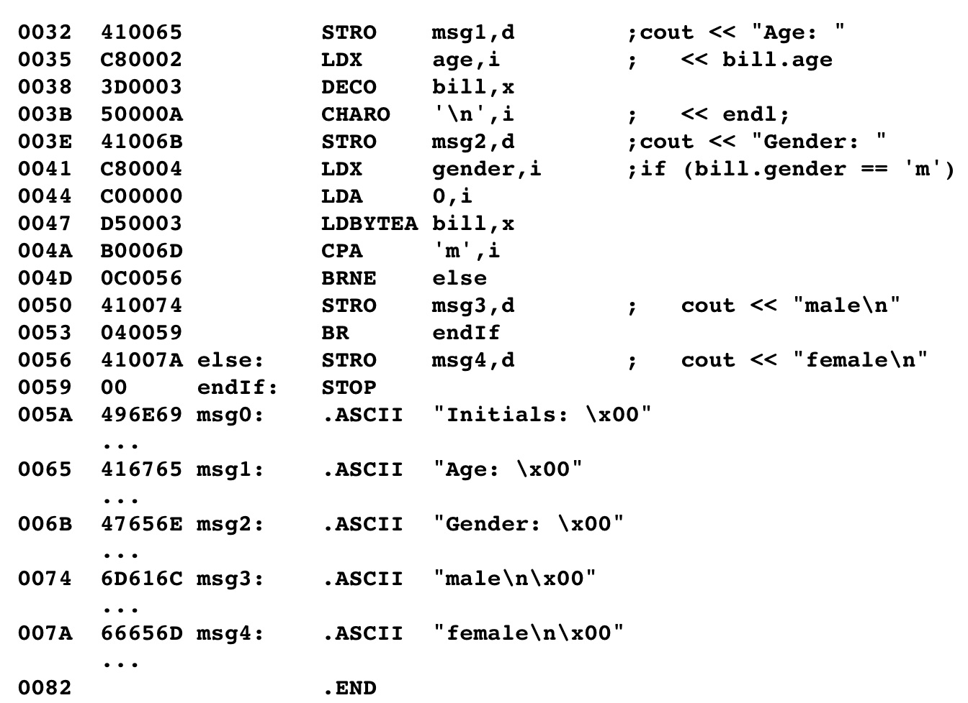
Structures at level HOL6 and Level Asmb5 (Cont’d)

Slide 59
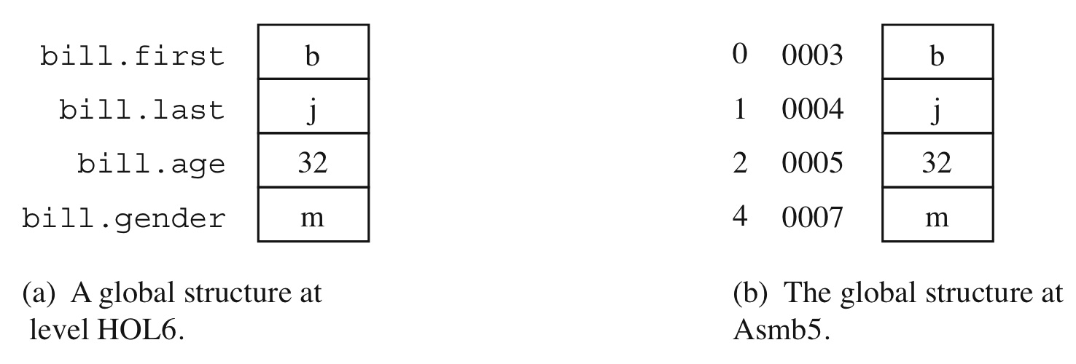
Structures at level HOL6 and Level Asmb5 (Cont’d)
Notes:
Here is a map of fixed memory for the HOL6 program and for the assembly program.

Slide 60
Linked Lists with a local pointer
Accesses a node:
Equate the pointer field to the first byte of the node.
Load the offset into the index register
Access the field of the node using stack-indexed deferred addressing (sxf)
Notes:
Linked Lists can be created on the stack using local pointers.
The pointer is set to the address of the first byte of the node
The offset is loaded into the index register
The field(s) of the node are accessed using stack-indexed deferred addressing.
For more details see powerpoint lecture on Fig 6.47

Slide 61
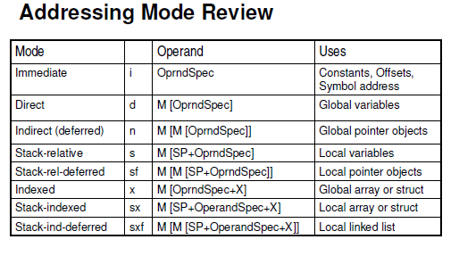
Summary
Notes:
Here are all the addressing modes for the Pep/8.
It shows how the CPU computes the operand and the uses for each mode.

Slide 62
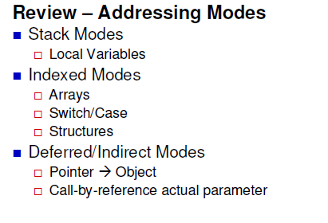
Summary
Notes:
Here is another way to remember them.
Local variables always go on the stack.
Indexed modes are used for arrays, switch or case statements, and sturctures.
Deffered or Indirect modes are used for pointers and call-by reference.

Slide 63
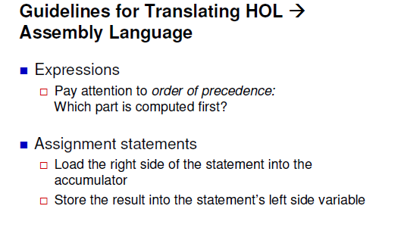
Summary
Notes:
Here are some guidelines for translating HOL6 into assembly language:
Determine the order of precedence. Which part is computed first?
Load the right side of the statement into the accumulator first.
Store the result into the left side’s variable.

Slide 64
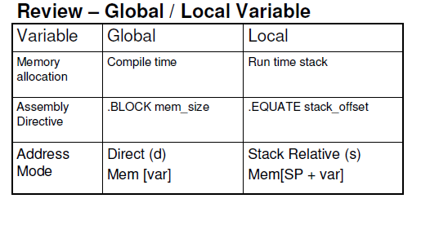
Summary
Notes:
Here is a review of the memory allocation, the assembly directive, and the addressing mode for Global & Local variables.

Slide 65
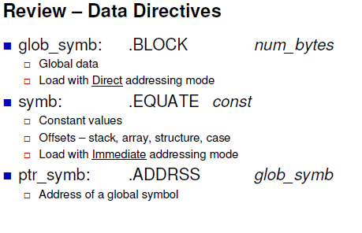
Summary
Notes:
Finally, here is a summary of the symbols that are created for different uses.
Global symbols for global data.
Symbols that hold constant values or constant offsets.
Pointer symbols that hold addresses.
This is the only lecture for this week. However there are details of figures and worked examples that will be useful to review.

